Slide 1

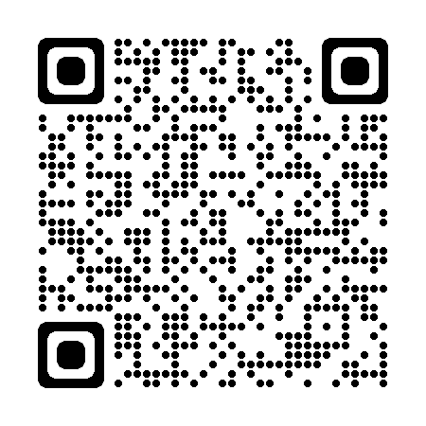
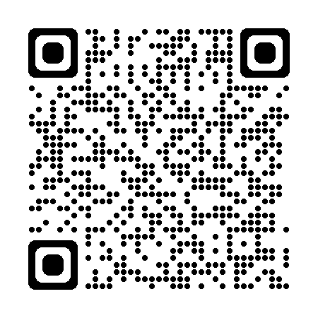
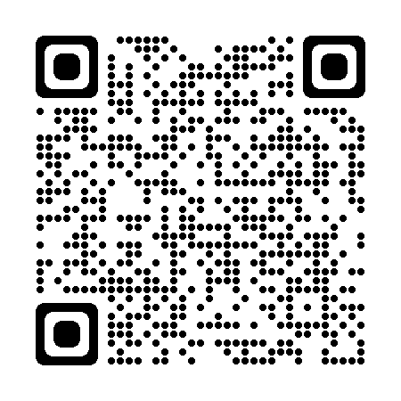
Email: ccss-researchsupport@cornell.edu
Computing
Shared & Dedicated Cloud Computing Resources
Secure Data Enclave
Software
Stata, SPSS, SAS
Python
R
Matlab
ArcGIS
Atlas.ti
MaxQDA
Data Services
Data Access
Secure Data Services
Data Sharing & Archiving
Results Reproduction
Consulting
Popular Topics:
Qualitative Methods
Data Cleaning
Visualizations
Survey Analysis
Finding Data
Web Scraping
Text Analysis
Request Appointment

